Slide 1

2013-2014
Year in Review

Slide 2


Review of Program Goals
We want district staff to:
Move More
Eat Smart
Stress Less
Lose Weight
Quit Smoking
How do we accomplish these goals?
Health Awareness
Health Education
Health Promotion

Slide 3
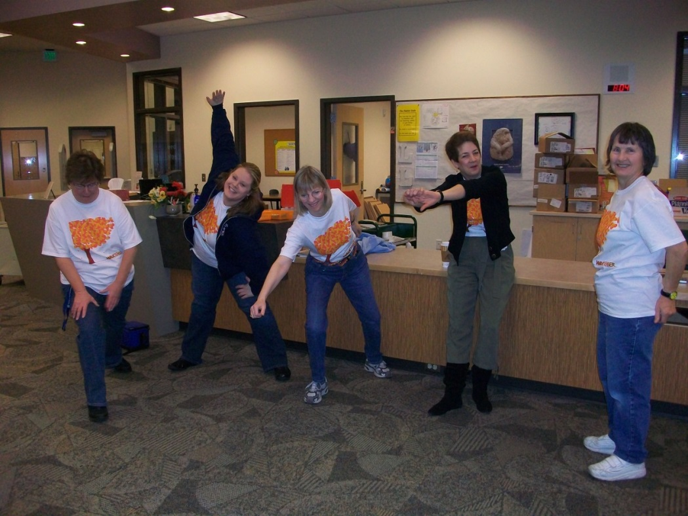

The Year in Review
Walktober
Flu Vaccine Clinics
November Nutrition Challenge
The Wellness Challenge® 2014
Ironman
EAT Smart Nutrition Challenge
Weight Watchers at Work
  Silver Lake
  Garfield
  CRC
Fitness Classes at schools
Bike to Work Campaign
Stress Management Workshops
Wellness Wednesday Newsletter
Wellness Champions
CRC Wellness

Slide 4

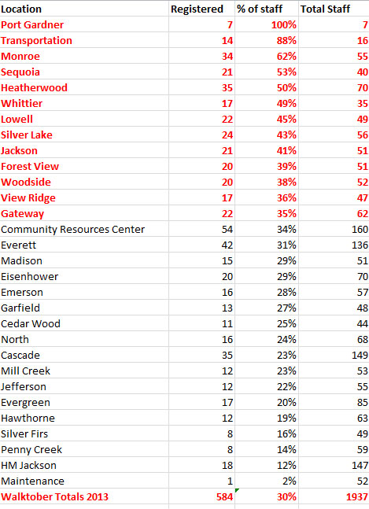
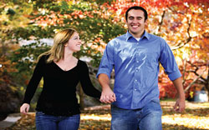


Slide 5
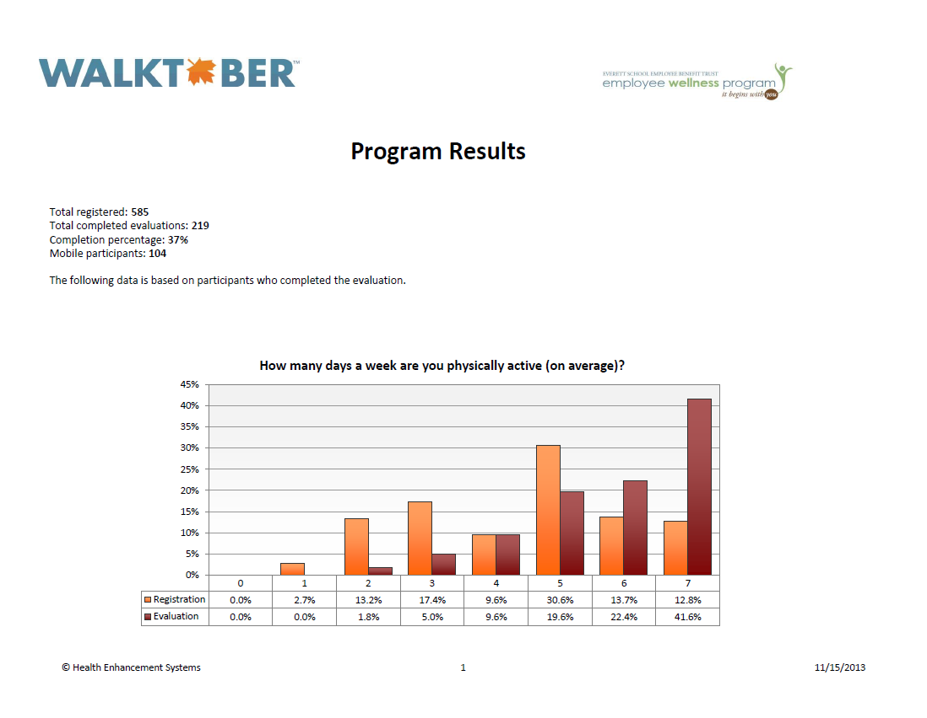

Slide 6
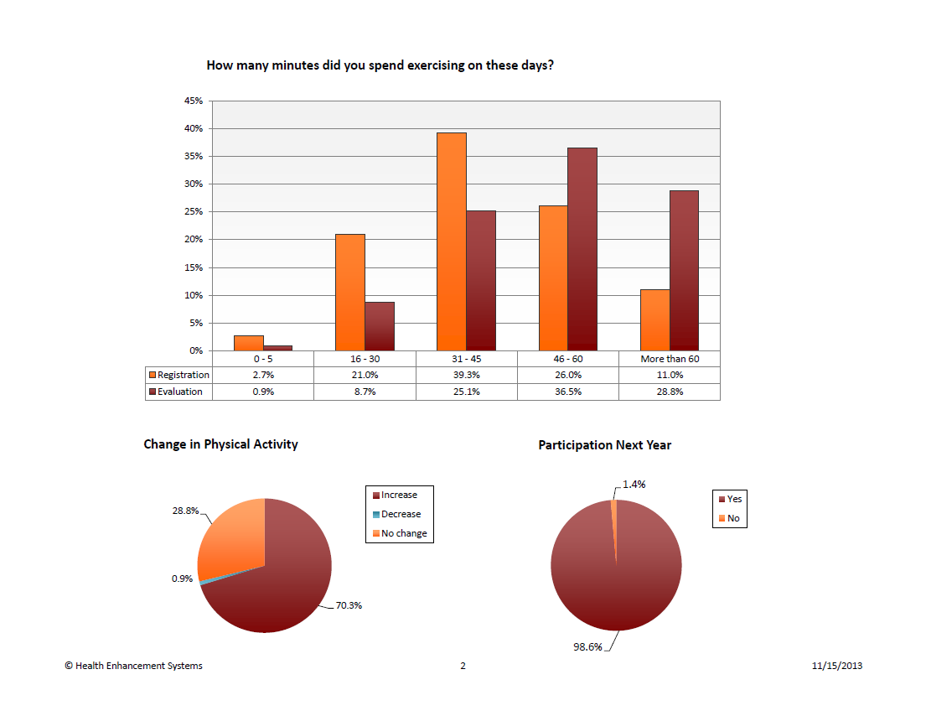

Slide 7
WALKTOBER Success Stories
"Walking more has helped me to be more successful with my workout program. I feel better physically. It has helped to distress me. I would definitely recommend everyone do this. It is not that difficult. Dianne Hanson
"Exercising every day keeps me energized. Walking is my favorite form of exercise. when I regularly exercise I stick to a healthy eating routine. I do less unhealthy snacking. The Walktober program was great. Karen Stolworthy
"I have been walking over a year now. I've lost 60 pounds and feel really healthy. I am a grandma and wanted to get on the floor with my babies and play. Thanks for this program, it's fun!“ Kathy Bogart
"Walktober was a perfect program to train for my fourth 1/2 marathon on October 27th. I dropped 21 minutes and got my best time. Thank you Walktober.
Thet Thet Win
"I noticed an increase in my energy level, which made me feel positive an happy!“
Torri McEntire
Over 370 WALKTOBER participants (63%) earned T-shirts for logging 30 minutes or more of exercise 24/31 days in October. This was a RECORD!

Slide 8

Fitness Classes
New system this year
  Sites and Wellness Teams requested their own classes
  Participants signed up on Google Docs.
  The more that signed up the cheaper the class.
  Worked VERY well
    150 participants took Yoga, Zumba, Boot Camp and Zumba Tone after school
    Classes at: Gateway, HM Jackson, Silver Lake, Lowell, Madison, Garfield, North, Cascade, Community Resource Center, and Heatherwood
“Having access to the EPS classes (like Zumba and Yoga) have made it easier for me to commit to staying active and noticing the difference that it makes! It also has been great to visit other schools and get to know some other staff in other buildings”.

Slide 9
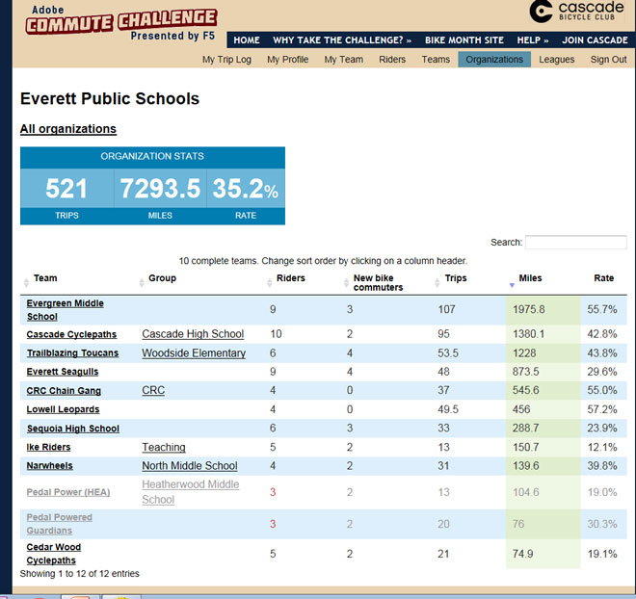
Bike to Work
“I made a concentrated effort to commute on my bike a lot more during the month of May for the bike commute challenge. It also encouraged me to get out and ride with friends and colleagues, which was a blast! In addition, it connected me with other bike riders at my school site”.

Slide 10

Flu Vaccine Clinics
2013-2014
Worked with vendor
“Get a Flu Shot”
6 Clinics
650 Vaccines
Billed through Insurance
(saved the Trust $16,500)
Received a FREE flu shot and did not get the flu this year | 49.07% 132
Fewer sick days this year | 24.16% 65
“Been getting the free flu shots for
4 years now and no flu”!

Slide 11

31-Day Eat Smart Nutrition Challenge
A different healthy eating challenge every day throughout the month of March (National Nutrition Month).
Participants: 165
“I drink more water and have added more fiber to my diet. My blood pressure is lower and so is my cholesterol because I eat healthier. I use salad plates for my dinner meal and pack a healthy lunch”.

Slide 12

The Wellness Challenge 2013
  180 Earned an incentive in Program Period II
The Wellness Challenge 2014
  205 enrolled
  1st Qtr. Lottery-95 eligible for lottery drawing
  20 reward cards distributed
“I used to eat everything in sight. I learned about fruits and veggies and now it is so easy to eat them all day long. The Wellness Challenge taught me healthy habits and now it just has become a way of life for me.
I am so happy”!!!!

Slide 13

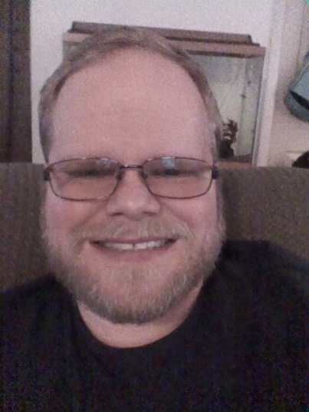
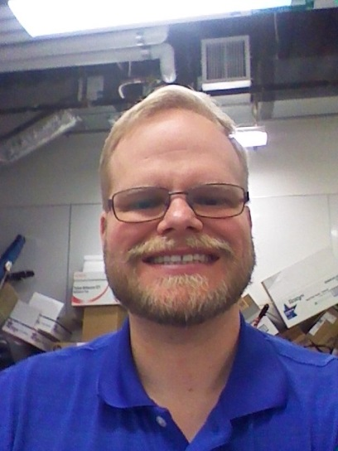
Weight Watchers at Work
Weight Loss
2013-2014
Garfield 100 lbs.
Silver Lake 150 lbs.
CRC 408 lbs.
Total Weight Loss 658 lbs.
48 lbs. (and counting) and a new belt☺

Slide 14
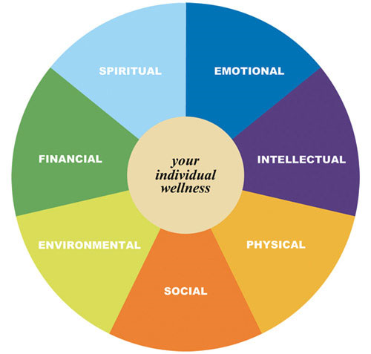
Cultivating Resilience
Stress Management
3-hour workshop
  35 attendees
  Insights
    Physiology of Stress
    Cognitive Behavior (Mind over Mind)
    How and why we react and respond the way we do to stress
    Stress vs. Stressor
  Skills
    Cognitive Behavior
    Mindfulness
    Deep Breathing
    Relaxation Techniques
    Emotional Awareness
    Wellness Wheel as a tool for more work/life balance
“I love the idea of Cultivating Resilience because it changes "stress" for me.
I appreciate the idea that I am in control not "stress." The Wellness Wheel is a tool that I will refer to. Deep breathing is a tool that I will integrate into my daily world as well. And lastly, being MINDFUL in what I do.
That is huge”!

Slide 15
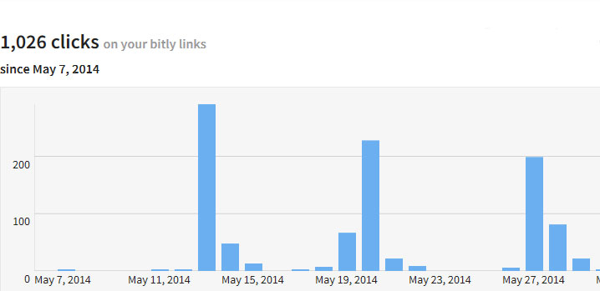
Wellness Wednesday
Average Clicks per week = 350
“I regularly read the Wednesday Wellness newsletter because I know it is only one page. It is great information each week. Continue to keep it short. I do enjoy seeing the inspirational stories of district staff”.

Slide 16
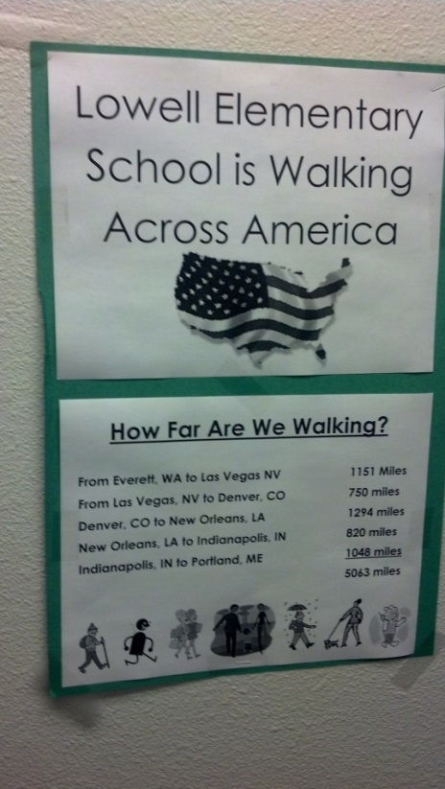
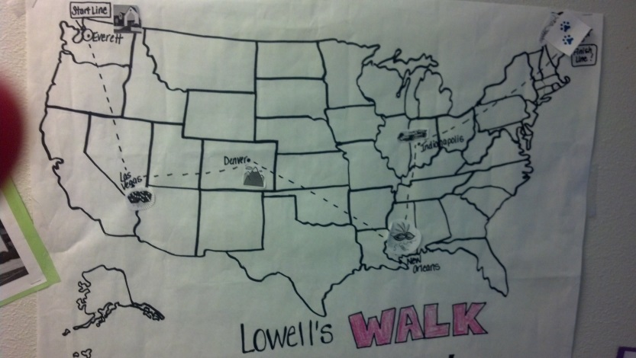
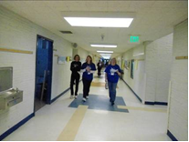
Wellness Teams
Wellness Team Scorecard
  Wellness Grant Dollars
    Lowell: $500
      Walk Across America
    Monroe: $500
      Stress Management Lending Library and Healthy Nutrition/Cooking class
    Whittier: $225
      Healthy Snacks Class
    Port Gardner: $250
      Squords
      Healthy Nutrition Class
Wellness Team Recognition Event
  25 attendees

Slide 17
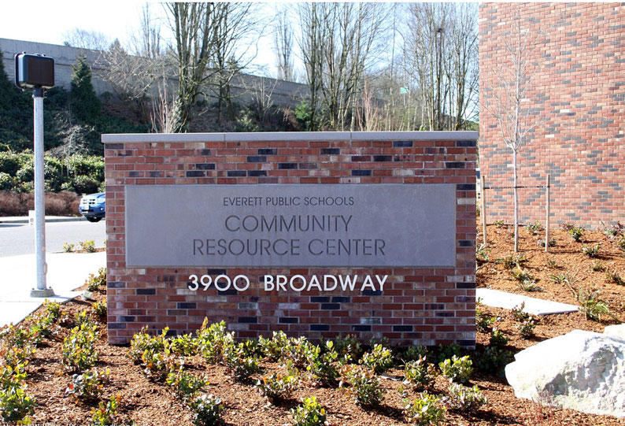
Community Resource Center
Started a Wellness Team with 10 members who meet every other month to plan “Wellness Wednesday” and other health related activities for the CRC.
Wellness Wednesdays: Every other month with a focus on health related themes. Healthy Pot-Luck, and health related activity at each department.
CRC Wellness Room has over 35 users. Use is increasing each month. Last month over 295 visits by CRC staff.
Walking Groups
Very little elevator use☺.

Slide 18
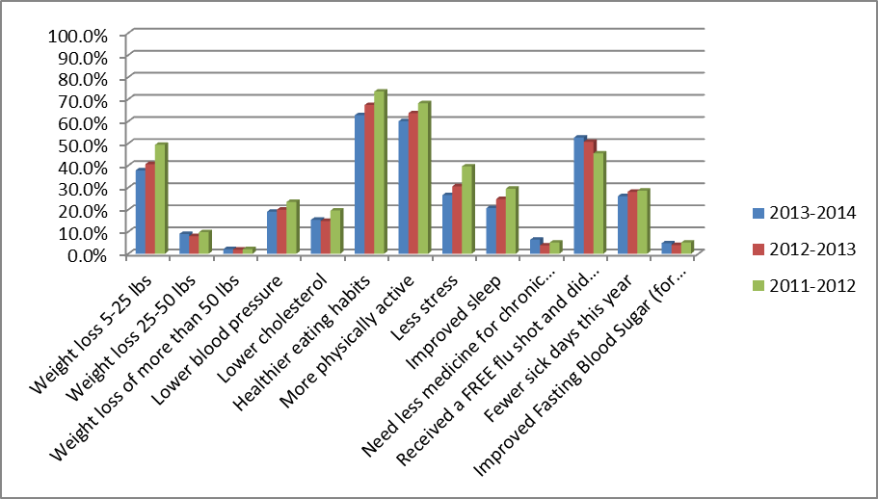
Health Improvements Self-Reported
“Less medication needed for high blood pressure and high cholesterol. I am now in the habit of exercising every day and if I miss getting my exercise in, I feel bad”.

Slide 19
Wellness Culture
The mission of the employee Wellness Program is...."to create a culture of wellness by promoting opportunities that enhance the overall health and quality of life for all district staff".
From your experience and the experience you have witnessed with your colleagues in our district, to what degree do you feel our employee wellness program is meeting this vision.

Slide 20
Culture
2013-2014 Wellness Program Survey
The goal of the EPS Wellness Program is to "create a culture" of Wellness, since the inception of the Wellness Program do you agree or disagree with the following statement. Please read the statements below and then rate all that apply.
Answer Options | Do not agree | Agree somewhat | Strongly agree | Response Count
I notice that my colleagues and I are more conscientious about our health. | 22 | 165 | 138 | 325
Wellness Program activities have helped to create a greater sense of camaraderie at my workplace. | 41 | 167 | 112 | 320
There is more conversation at work about health and wellness topics. | 41 | 146 | 136 | 323
We offer healthier food options at staff meetings and gatherings. | 62 | 154 | 106 | 322
Having a district wellness program in place makes me feel that my health is an important priority of district leadership. | 24 | 103 | 199 | 326
Seeing district leadership involved in wellness activities inspires and motivates me to participate too. | 63 | 149 | 113 | 325

Slide 21
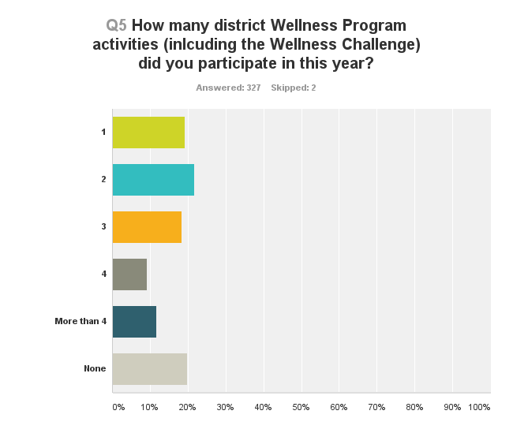
Participation 2013-2014
If you answered NONE to the question above, please help us understand why by selecting ALL that apply below.
Answer Options | Response Percent | Response Count
I already have a healthy lifestyle and do not feel the need to participate. | 29.4% | 30
I do not like tracking or logging my activities or healthy behaviors | 39.2% | 40
I feel I don't have time to include exercise or healthy eating in to my lifestyle | 7.8% | 8
I feel the challenges are too difficult for me | 5.9% | 6
I don't feel my employer should be influencing my health | 4.9% | 5
I am concerned about confidentiality | 5.9% | 6
answered question |  | 102
skipped question |  | 227

Slide 22
Superintendents Leadership Team Participation 2008-2014

Slide 23
Principal & Asst. Principal Participation 2008-2014

Slide 24
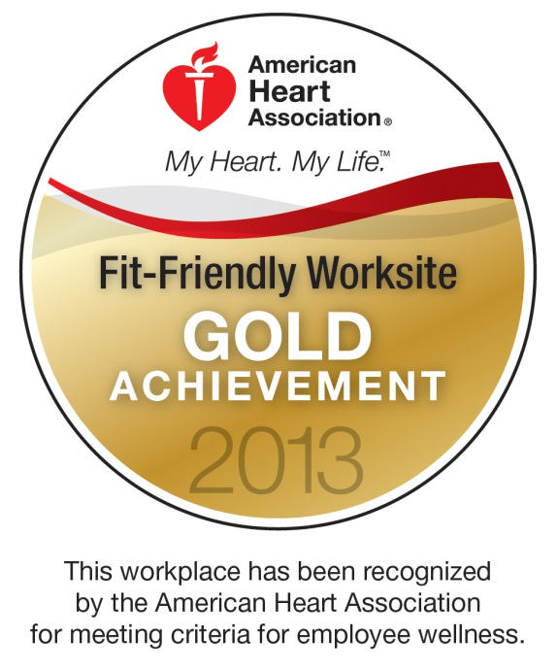
Awards/Recognition
American Heart Association
  Fit Friendly Worksite Award
  3rd consecutive year

Slide 25
Feedback
Positive
Having a program like this district wide is great it shows employees are valuable and connects us.
I appreciate the fact that our health is important.
I'm in excellent condition mentally and physically because of the EPS Wellness Program. That's all that I want to say. Please keep it going.
I think it's a wonderful program that shows that the health of the employees is important to the leadership.
It is so great to have weight watchers at work. The CRC is creating a culture of healthy eaters! So great not to have unhealthy snacks around all the time! Lots of weight has been lost this year alone! We are a healthier community!
This is a place where I feel that healthy lifestyles are beginning to be a high importance. We are not completely there but we will get there if the Trust continues to support this program.
Thank you for all that you do. This is an outstanding part of EPS culture, as it says loudly and clearly to everyone: You matter. We care about you. We care about one another.
I have benefited from participating in at least 5 of the programs offered this year. Meeting new people and getting to know our staff better has improved my outlook on the district as a whole. When Wellness programs are offered, I feel the district cares about my health and well-being. I recognize the importance of exercise and different types of exercise (mind and body) to sustain the ability to be well.
Not so Positive
The Benefit Trust should be used to LOWER health care costs and increase benefits for all employees - not to fund the Wellness Program.
I can't believe the money wasted. I hope you are helping a lot of people. This survey took much longer than a minute. Just another example of the waste of time and money this program is.
I know people enjoy the wellness program being available but it seems the teachers are so overwhelmed they do not enjoy the system for tracking - it's just one more thing they have to do.
I want the check without jumping through hoops. I am very healthy and deserve the money, but it's time consuming.
Stop giving money to the fatties and give the money to teachers and kids.

Slide 26
Staff Wellness = Student Wellness
“I love that it is OK to spend time at school talking about our health…sharing recipes for fresh food dishes, helping each other with motivation, especially as we age and need this more and more. Making wellness a priority has opened up talking and walking the talk with my students. The later has helped me connect with various students who have similar interests”.

Slide 27
Testimonials
I just wanted to let you know that the Wellness Program has really helped me change my life. Since I started participating in the Wellness Program, I’ve taken yoga classes, improved my diet, paid more attention to stress and ways to reduce it! Now I am eating healthy every day, going to Zumba at Lowell twice a week, started a yoga class at Jackson on Thursdays, and am rowing before school two days a week! I feel great, and your program got me started.
Thanks!
Janet

Slide 28
2014-2015
Wellness Program Goals
Culture
  Goal: Define what a healthy district culture looks and feels like.
    Set Goals (SMART)
    Collaborate with leadership on best way to accomplish goals and collect data.
    Increase Wellness presence at leadership and principal meetings. More Wellness “face time”.
    Infuse more staff “wellness” in to district culture, policies and strategic planning

Slide 29
2014-2015
Wellness Program Goals
  Engage staff who are already HEALTHY!
    Challenges and Competitions
    Buddy Up (adopt a colleague to coach, motivate, encourage, inspire and incentivize both to reach goals).
  Explore new web-portal and incentive structure to engage more district staff
  Improve Wellness Program promotion. Strategize with Trustees, school principals, leadership and wellness teams how best to promote Wellness Program opportunities.
  Create curriculum for comprehensive Stress Management (clock hours?) and Weight Management.
  Expand Fitness focus. Increase fitness classes and workout opportunities at district sites.
  All district health fair at CRC in conjunction with annual Flu Vaccine clinics and open enrollment.
  Update, expand and improve Wellness page on district site.
  Create more opportunity for health education for staff through online learning modalities.
  Increase participation in WALKTOBER (35% participation) and other seasonal campaigns.
  Expand Wellness “department” to include interns or health promotion graduates for more input, collaboration, education and reach in the district.

Slide 30
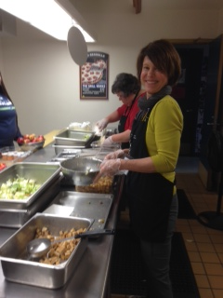
How else do I spend my time?
Project Empathy
  Goal is to spend a “day in the life” of our district employees throughout 2014 and 2015.
  The purpose of this goal is to gain a better understanding of how the Wellness Program can best support the unique needs of the many positions in our district.
Presentations
  Everett Public Schools: Wellness Sprinkles
    Annual Presentations: Office Managers, Transportation and New Teacher Orientation
    Wellness Support: Health Room Assistants, Para-Educators, Food Services, Maintenance, Custodians
    Education: Stress Management Workshops, Healthy Nutrition and Cooking, Lunch and Learns
  Off Site
    American Heart Association; King 5 News, Fox News
    Western Washington University
    Oregon Education Association: Annual School Employee Wellness Conference
    Health Worksite Summit
Professional Development
  AHA Fit Friendly Forums
  OEA Conference
  C.A.R.E. (Cultivating Awareness and Resilience in Educators) Retreat at the Garrison Institute, Garrison, NY (this summer???)
Serving lunch at Everett High

Slide 31
Thank You,
May you be well☺

